Slide 1
Building Your Team to Last Successful Onboarding and Mentoring Practices
Sarah Withee

Slide 2


Slide 3
Have you had an onboarding experience that was bad?

Slide 4
Have you had an onboarding experience that was horrible?

Slide 5
Have you been that person in that awful onboarding experience?

Slide 6
Outline
Misconceptions of Juniors
Benefits of Juniors and Interns
Benefits for Seniors and Teams
What Does Effective Mentoring Look Like?
Ensuring You’re Ready for New Juniors

Slide 7
Why?
Kept hearing BAD experiences from interns and juniors
I had some good and bad experiences

Slide 8
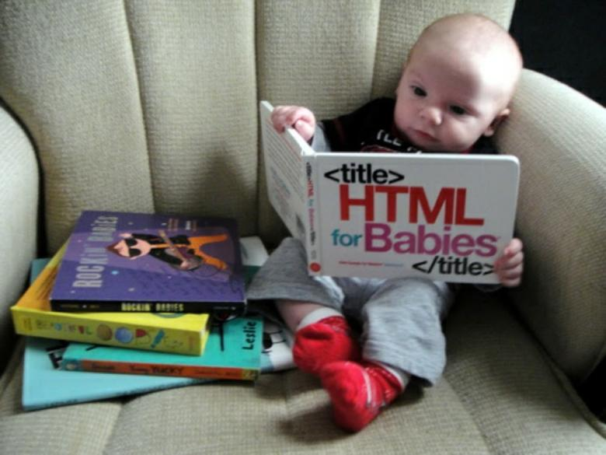
Who?
Juniors –
Fresh graduates of universities, code schools, boot-camps, or self-taught
Typically < 2 years experience

Slide 9
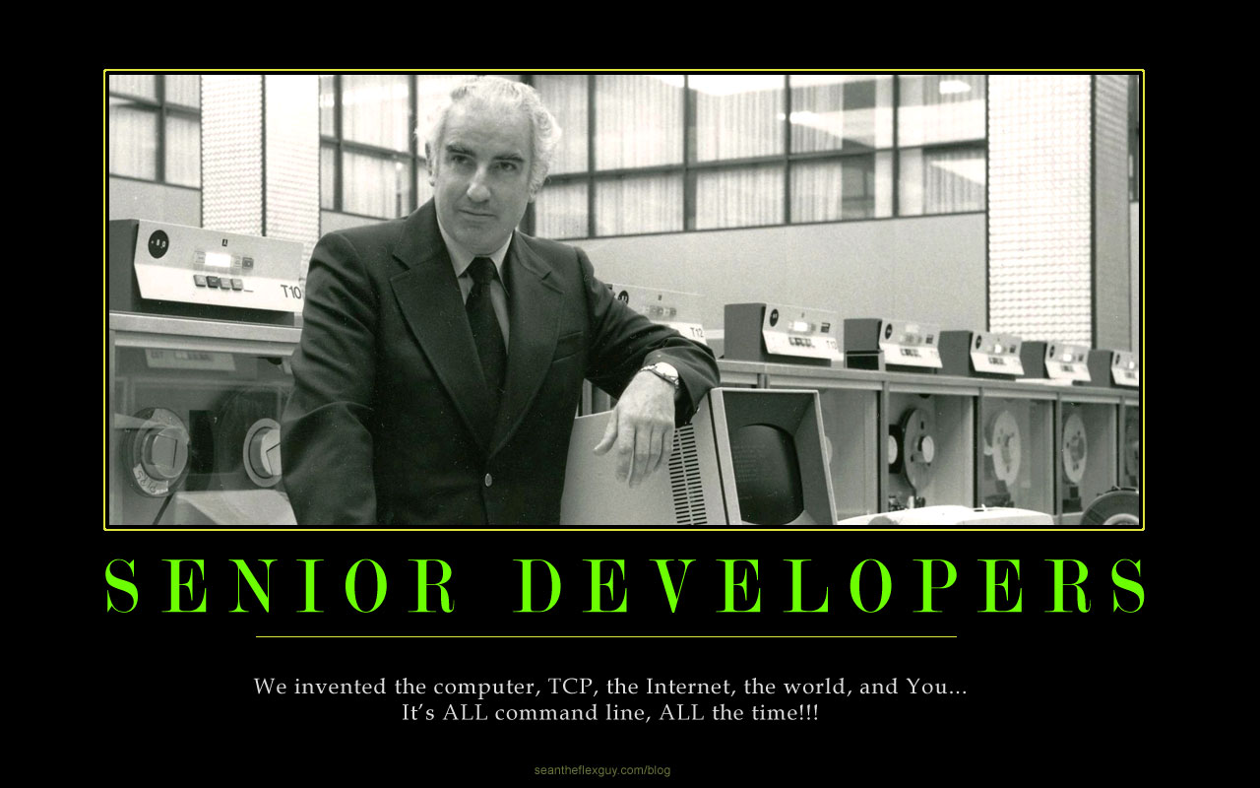
Who?
Seniors –
People with many years experience
Often some form of team lead
The one stuck with that junior
Notes:
Alt text:
We invented the computer, TCP, the Internet, the world, and You… It’s ALL command line, ALL the time!!!

Slide 10
Notes:
Alt text:
We invented the computer, TCP, the Internet, the world, and You… It’s ALL command line, ALL the time!!!

Slide 11
Who?
Note:
This is based from developer perspectives
Principles can apply to any type of team

Slide 12

Sarah’s Background
Loved programming on my Commodore 64
Went to college, dropped out, went back to finish
Taught C++ labs, later lecture, as undergrad

Slide 13
Sarah’s Career
Two internships
“Real World Job™” with onboarding program

Slide 14
Sarah’s Career
Total onboarding experiences:
8

Slide 15
Misconceptions about Juniors

Slide 16
Misconceptions about Juniors
Juniors are effective mind readers

Slide 17
Misconceptions about Juniors
Juniors understand exactly what’s expected of their code
… as they walk in the door

Slide 18
Misconceptions about Juniors
Juniors understand the nature of working on production code on a team

Slide 19
Juniors will get it right on the first try

Slide 20
Misconceptions about Juniors
Juniors are 20-year-olds fresh out of college/internships

Slide 21
Misconceptions about Juniors
Juniors all have the same knowledge from their education

Slide 22
Misconceptions about Juniors
Juniors are effective mind readers
Juniors understand what’s expected of their code as soon as they walk in the door
Juniors understand the nature of working on production code on a team
Juniors will get it right on the first try
Juniors are 20-year-olds fresh out of college/internships
Juniors all have the same knowledge out of their education

Slide 23
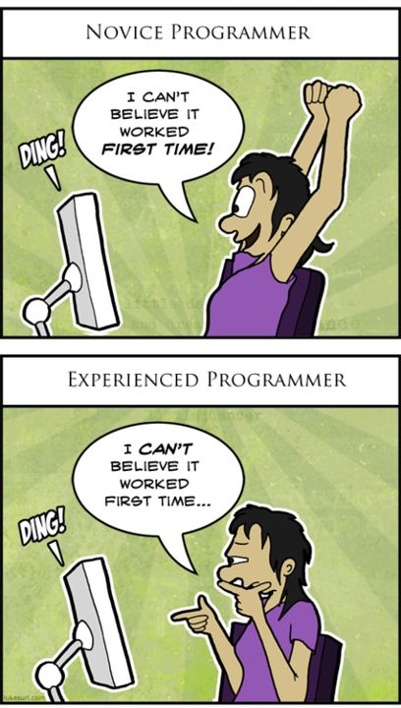
Misconceptions (Paraphrased)
Lack of experience != Lack of ability
Being new != Being stupid

Slide 24
Benefits for Juniors and Interns
Growth for the juniors

Slide 25
Benefits for Juniors and Interns
Put their energy to good use

Slide 26
Benefits for Juniors and Interns
Juniors discover their interests

Slide 27
Benefits for Juniors and Interns
Build good relationships with seniors
(or anyone with more experience)

Slide 28
Benefits for Juniors and Interns
Juniors are cheaper and easier to hire

Slide 29
Benefits for Juniors and Interns
They get involved in the workplace and community

Slide 30
Benefits for Juniors and Interns
Improve growth
Put their energy to good use
Discovering their interests
Build good relationships with seniors/experienced people
Cheaper/easier to hire
They get involved in the workplace and community

Slide 31
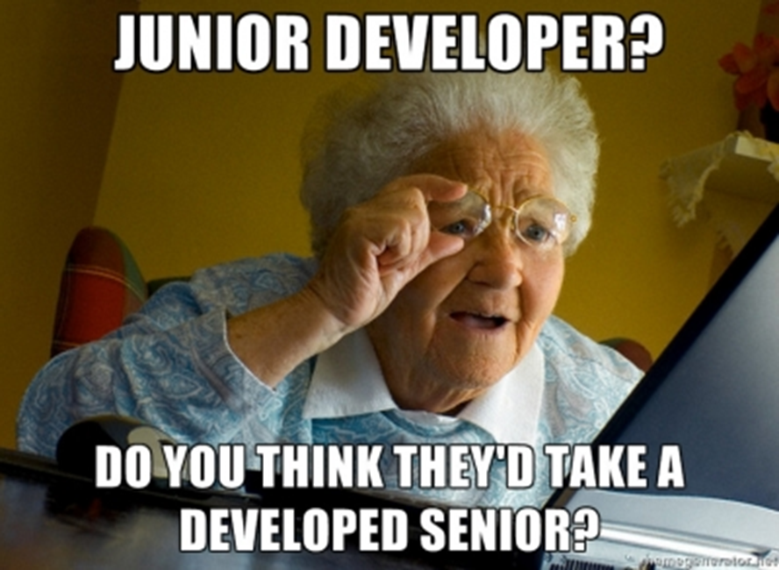

Slide 32
Benefits for Seniors and Teams
Time away from regular work

Slide 33
Benefits for Seniors and Teams
Reevaluating your/your team’s processes

Slide 34
Benefits for Seniors and Teams
A little more time in the beginning saves you MORE time down the road

Slide 35
Benefits for Seniors and Teams
See new ideas and technology

Slide 36
Benefits for Seniors and Teams
Break out of homogenity

Slide 37
Benefits for Seniors and Teams
Investing in the future of your team

Slide 38
Benefits for Seniors and Teams
Get more side work done

Slide 39
Benefits for Seniors and Teams
Time away from regular work
Reevaluating how you do things
More time spent in the beginning saves you MORE time down the road
See new ideas and technologies
Break out of homogeneity
Investing in the future of your team
Get more side work done

Slide 40
What Does Effective Mentoring Look Like?
Good Process
Good Communication
Guidance/Visioning

Slide 41
Effective Mentoring - Process
Good onboarding

Slide 42
Effective Mentoring - Process
Consistent standards

Slide 43
Effective Mentoring - Process
Not relying on junior to know what they need to know

Slide 44
Effective Mentoring - Process
Leaving opportunity to discover

Slide 45
Effective Mentoring – Communication
Schedule 1-on-1 meetings

Slide 46
Effective Mentoring – Communication
What do I ask?
“What’s going on?”
“What’s going well?”
“What’s not going well?”
“What can you use help on?”
“What can we help you with?”

Slide 47
Effective Mentoring – Communication
Reiterating that learning company procedures takes time

Slide 48
Effective Mentoring – Communication
Check on confused looks

Slide 49
Effective Mentoring – Guidance/Visioning
Make sure they have a project that’s doable

Slide 50
Effective Mentoring – Guidance/Visioning
Pairing

Slide 51
Effective Mentoring – Guidance/Visioning
Guidance on how to solve problems

Slide 52
Effective Mentoring – Guidance/Visioning
Get juniors’ advice

Slide 53
Effective Mentoring – Guidance/Visioning
Ensure junior understands what is going on, not just saying it

Slide 54
What Does Effective Mentoring Look Like?
Process:
Good onboarding
Consistent standards
Not relying on junior to know what they need to know
Leaving opportunity to discover
Communication
Schedule 1:1 meetings
“What’s going on?”
“What’s going well?”
“What’s not going well?”
“What can they use help on?”
“What can we help them on?”
Reiterating that learning processes/procedures of the company takes time
Check on confused looks

Slide 55
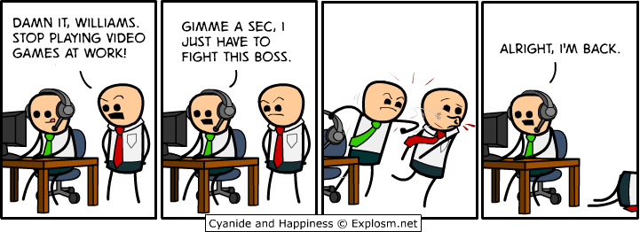
What Does Effective Mentoring Look Like?
Guidance/Visioning
Make sure they have a project that’s doable
Pairing
Guidance on how to solve problems
Get juniors’ advice
Ensure junior understand what is going on and not just saying it

Slide 57
Ensuring You’re Ready for New Juniors
Do you have a senior that can spend time answering questions?
(Preferably at least once a week for chatting)

Slide 58
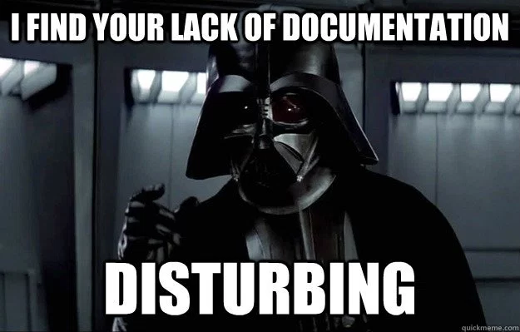
Ensuring You’re Ready for New Juniors
Are there adequate training resources?

Slide 59
Ensuring You’re Ready for New Juniors
Will they be given time to learn from them?

Slide 60
Ensuring You’re Ready for New Juniors
Will they be able to grow from these experiences?
(Even if they don’t stay at the company?)

Slide 61
Ensuring You’re Ready for New Juniors
The 3 P’s:
Planning
Projects
Pairing

Slide 62
Ensuring You’re Ready for New Juniors
Do you have a senior that can spend time answering questions?
Are there adequate training resources?
Will they be given time to learn from them?
The 3 P’s:
Planning
Projects
Pairing

Slide 63
Conclusion
Juniors and interns are GREAT people to have on teams

Slide 64
Conclusion
They come with a cost of extra time and energy from the team…

Slide 65
Conclusion
They provide work, energy, enthusiasm, and new ideas

Slide 66
Conclusion
They get great experience

Slide 67
Conclusion
Everyone benefits by working together to onboard and mentor the new teammate

Slide 68
Thank You!
Sarah Withee
@geekygirlsarah
sarah@sarahwithee.com
I love hearing about what works and doesn’t. Please share your experiences!

